Slide 1
Grammar Workshop for parents
Monday, 20th February 2017 - St Mary’s
Tuesday, 21st February 2017 – St Saviour’s
Aims:
to look at the grammar curriculum in each year group
to know the terminology used by teachers and pupils
To know expectations for end of Key Stage tests in year 2 and 6

Slide 2
2014 National Curriculum
The 2014 National Curriculum outlined new expectations for grammar.
It states:
The grammar of our first language is learnt naturally and implicitly through interactions with other speakers and from reading. Explicit knowledge of grammar is, however, very important, as it gives us more conscious control and choice in our language.
Notes:
Much is learnt through literacy and reading, some naturally and through grammar lessons
Good for learning languages
Good for rules in writing (and experienced writers knowingly breaking them for effect)
All teachers had to train – ahead of game

Slide 3
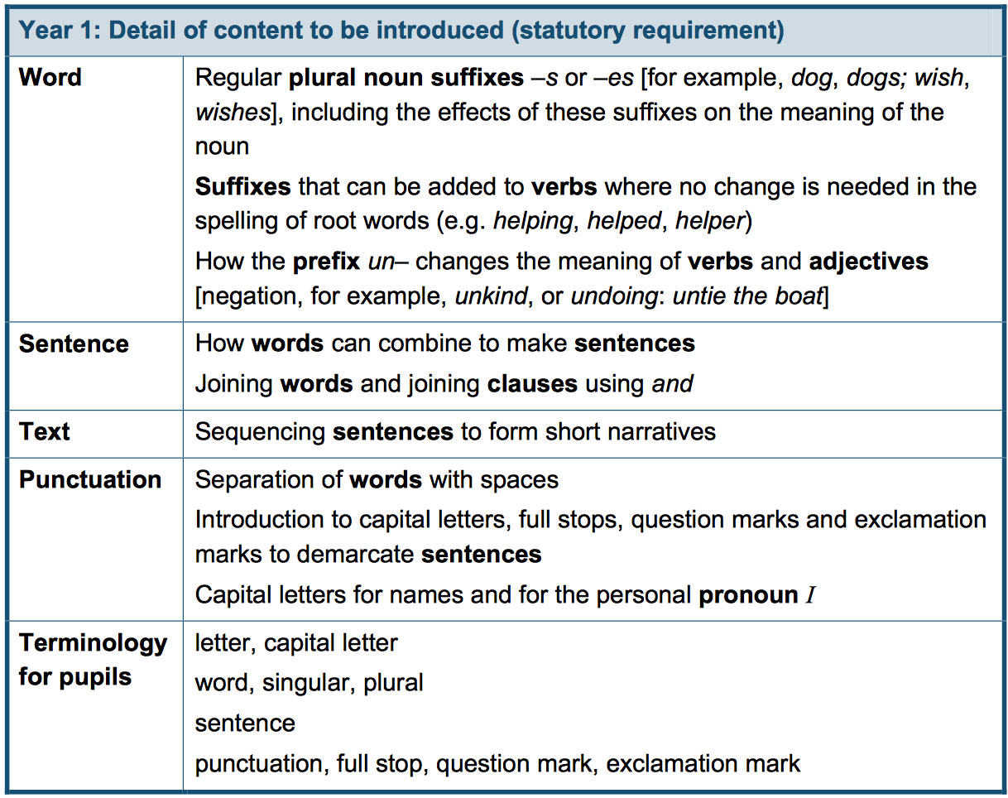
Year 1

Slide 4
Year 2

Slide 5
Suffixes
To form nouns
happy (adjective) - happiness (noun)
To form adjectives
beauty (noun) – beautiful (adjective)
To form adverbs
Wonderful (adjective) – wonderfully (adverb)

Slide 6
Coordinating Conjunctions
and but or so
Susan and Amara met in a café.
They talked and drank tea.
Susan got a bus but Amara walked.
Notes:
Key skill
Children learn the co-ordinating conjunctions (and but so or) – two balanced clauses (clause not official terminology at this stage) Link an equal pair
Displayed in all classrooms (blue)

Slide 7
Subordinating Conjunctions
when if that because
We can watch TV when we have finished.
If we eat our dinner, we can watch TV.
Notes:
We use to make a subordinate clause.
Can link two clauses (although clauses not a terminology for chn)
Can also move the front of a sentence

Slide 8
Different types of sentences
Statement – You are my friend.
Question – Are you my friend?
Command – Be my friend.
Exclamation – What a good friend you are!
What big teeth you have, Grandma!
How beautiful Cinderella looks in that dress!
Notes:
Exclamation sentence must start with what or how. Although can use exclamations in writing to express surprise etc and for interjections (help!) these are not exclamation sentences

Slide 9
Year 2

Slide 10
Working at the expected standard in Year 2
The pupil can write a narrative about their own and others’ experiences (real and fictional), after discussion with the teacher:
demarcating most sentences with capital letters and full stops and with some use of question marks and exclamation marks
using sentences with different forms in their writing (statements, questions, exclamations and commands)
using some expanded noun phrases to describe and specify
using present and past tense mostly correctly and consistently
using co-ordination (or / and / but) and some subordination (when / if / that / because)
spelling some words with contracted forms
adding suffixes to spell some words correctly in their writing e.g. –ment, –ness, –ful, –less, –ly*
Notes:
Above – change ‘some’ to ‘most’

Slide 11
Test Questions for year 2
Have a look at the sheets to see what a year 2 child is expected to be able to do.

Slide 12
Year 3
￼Punctuation: Introduction to inverted commas to punctuate direct speech
Terminology: preposition, conjunction, word family, prefix, clause, subordinate clause, direct speech, consonant, vowel, inverted commas (or ‘speech marks’)
Notes:
Note sentence uses conjunctions (we saw earlier), adverbs (now extended) and prepositions & clauses
Words like suffix, subordinating are now being used (as opposed to being a concept in year 2)

Slide 13
Word Classes
A Clause is a group of words with a verb.
Conjunctions link two clauses:
It was raining but we were indoors.
Some express time - when
place- where
cause - because
Notes:
A clause is a special type of phrase with a verb. It can be a complete sentence. It can be main or subordinate.

Slide 14
Word Classes
An adverb or adverbial is a word or phrase that can modify a verb, an adjective or another adverb. It can answer the question when, where and how was something done.

Slide 15
Adverbs
Usha soon started snoring loudly.
(Adverbs modifying the verbs)
The match was really exciting.
(Adverb modifying the adjective)
We don’t get to play very often.
(Adverb modifying another adverb)

Slide 16
Adverbials
The bus leaves in five minutes.
She promised to see him last night.
Can you spot the adverbials?
Yesterday, I checked my homework really carefully but I couldn’t find any mistakes.

Slide 17
Prepositions
Children learn that they are position words e.g. on in under above beneath
The boy sat underneath the tree.
Or direction words
He went to the park.
I haven’t seen my dog since this morning.
I’m going since no one wants me here.
(not a preposition)
Find the prepositions:
She’ll be back from Australia in two weeks.

Slide 18
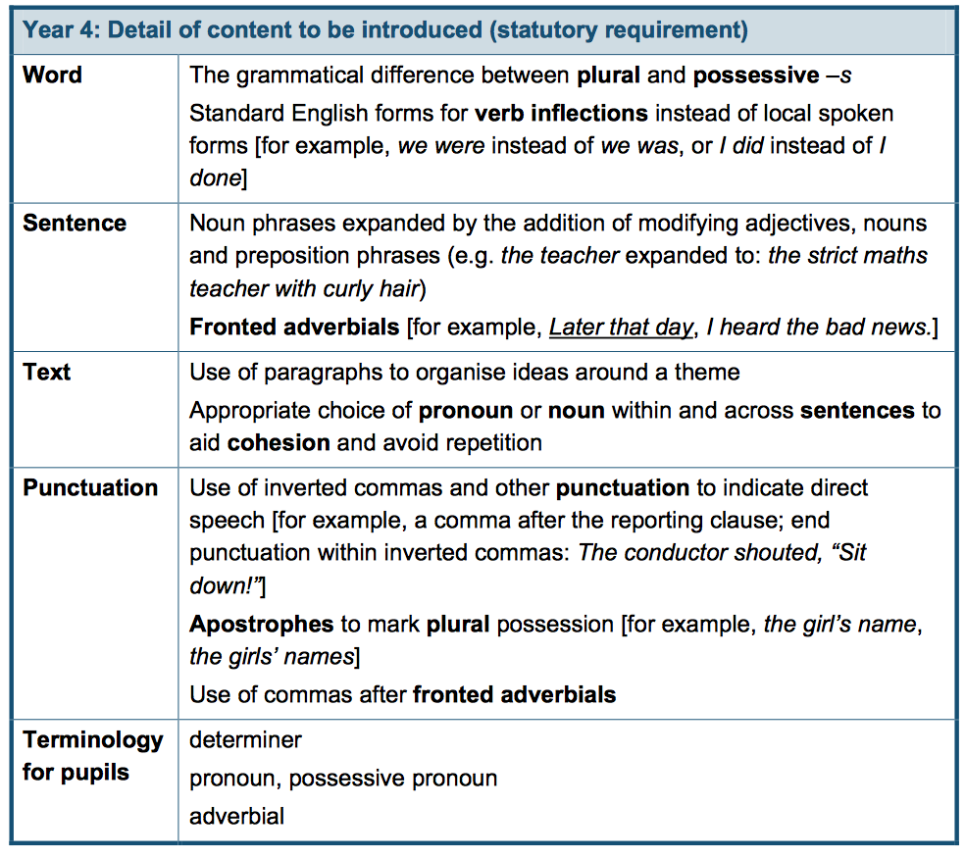
Year 4

Slide 19
Types of determiners

Slide 20
Types of pronouns
Subject pronouns:
I, he, she, it, you, they, you and we
Compound pronouns:
Myself, herself, himself, itself, yourself, ourselves, yourselves, themselves
Possessive pronouns:
Mine, hers, his, its, their, ours, yours

Slide 21
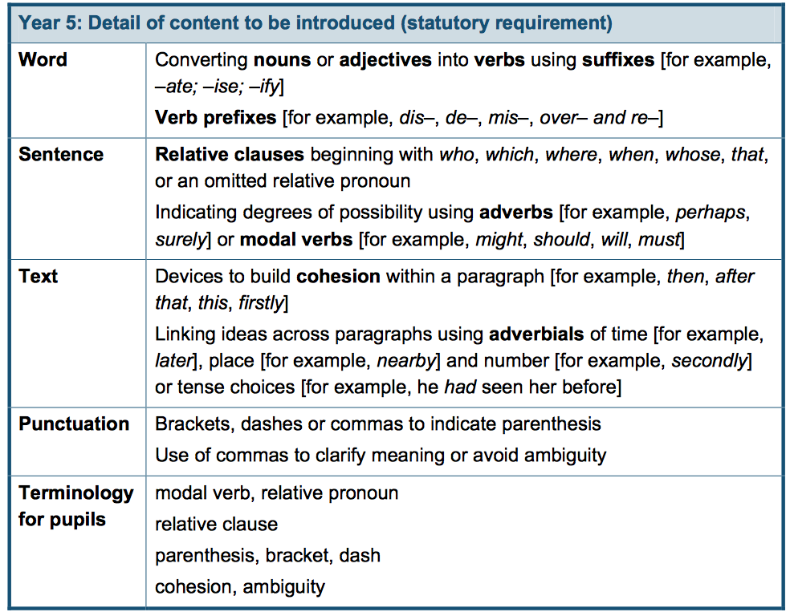
Year 5
Notes:
Relative clauses
Modal verbs
Punctuation has now been extend to include parenthesis and extend use of commas

Slide 22
Year 6

Slide 23
Year 6
ellipsis, hyphen, colon, semi-colon, bullet points

Slide 24
Test Questions for year 6
Have a look at the sheets to see what a year 6 child is expected to be able to do.

Slide 25
Adjective or adverb?
Notes:
Nouns and verbs

Slide 26
Preposition or subordinating conjunction?

Slide 27
Grammar Workshop
Any questions?

