Slide 1
School Values

Slide 2
Our School Vision
School Vision
Our vision is for St Saviour’s to be a place of transforming growth, where Christian education inspires children and adults for achievement in the whole of life.

Slide 3
Our School Values
FAITH
LOVE
FORGIVENESS
RESPECT
TRUTH
TENACITY
SERENITY

Slide 4
Why Values, not Rules?
Our aim: Children taking responsibility for their behaviour and their actions, through the values chosen for them by their community and faith.
Values provide greater aspirations than rules
Rules require remembering. Values require thinking.
You can ‘bend the rules’. You cant bend values!

Slide 5
Thinking about our values…
We live out our Christian Values because we’re made in God’s image.
We strive to show Love, Truth, Respect, Forgiveness, Tenacity, Serenity and have Faith.
We show this in our behaviour, our work and our relationships.

Slide 6
Optimised Learners
We want our children to become independent thinkers who make good choices.
Approach challenges with the tenacity and resilience shown by Jesus.
To have a ‘growth mindset’ and to love learning.
To know that with rights come responsibilities.
To be problem solvers.

Slide 7
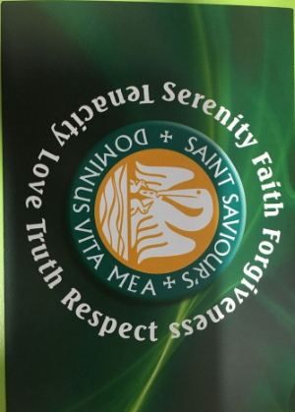
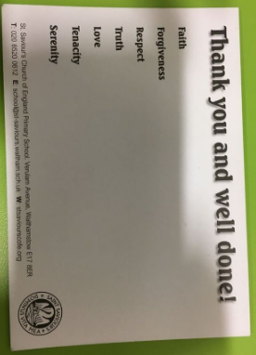
We celebrate children’s brilliance!
Praise with regular reference to School Values
Weekly Values card
Weekly Star of the Week certificate
‘Class dojos’ reward system – usually linked to learning
Good to be green

Slide 8
Where do we go from here?
In order to continue to embed the values across the Federation, we will soon be working on character education. This is the idea of focussing on a specific value (we plan on beginning with 'Respect' for a half term. This means that throughout every lesson we will be looking at examples of respect, for example, respect shown historically, how we can respect the landscape, respect between characters in books etc. We hope this will develop the children's understanding of values outside the school setting.

